Slide 1
Online CV/Resume
Name: Muhammad Salman
Sap Id: 72373

Slide 2
INTRODUCTION
A personal website showcasing resume details which is editable
Helps present skills, experience, certifications and education online
Allows quick sharing with employers through download button and also print button.

Slide 3
Designs and Features
Header with name, photo, professional title, print and choose new image
Profile, Skills, Experience, Certifications, Education Sections
Contact Me section (WhatsApp, Facebook,)
Download Resume button (on click added PDF)
Fiverr and professional social links

Slide 4
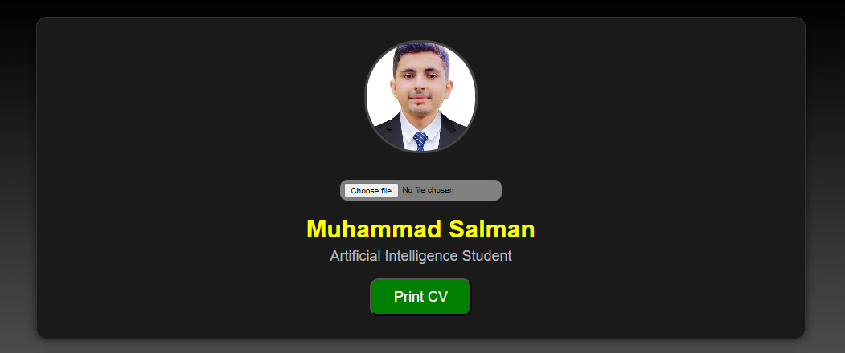
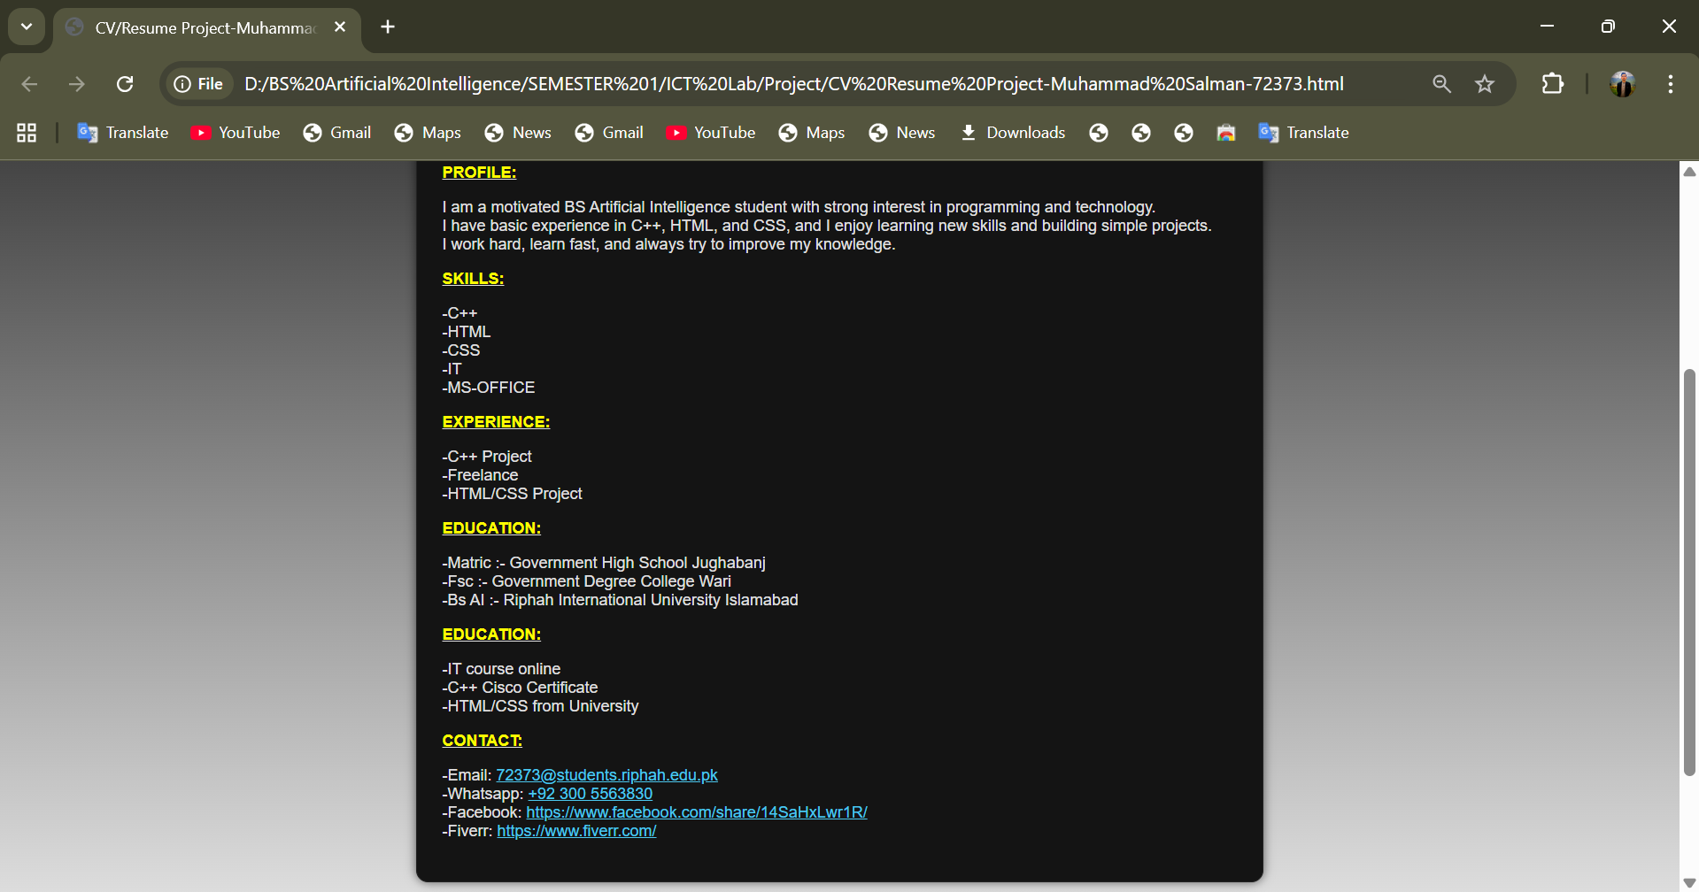
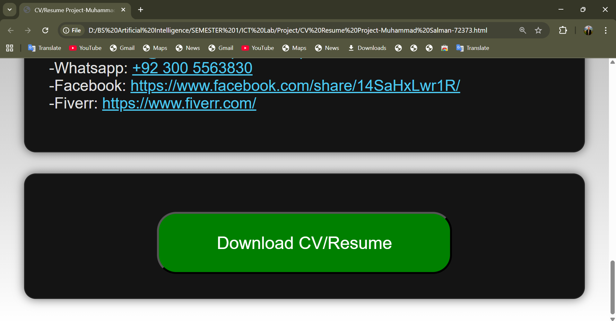
OUTPUT Preview / Overview
1st Container
Picture+Name+Title+Print+New Image
2nd Container Profile+Skills+Experience+Education+Certifications+Contact
3rd Container Download Button linked with pdf

Slide 5
CONCLUSION
Learned HTML/CSS/Basic-Java Script layout and structure
Improved understanding of resume formatting
Future improvements: better design, responsiveness, animations.

Slide 6
Thanks, You

